Slide 1
Vocational Skill Based Training for Underprivileged
https://beacon.siesgst.ac.in/​

Slide 2
Project Beacon is a small step to give meaning and purpose to someone's life.
As it is rightly said "A candle loses nothing to light another candle"
We pledge to be the candle of inspiration and go on to light the Beacon of Knowledge.

Slide 3
Qualification:
*Anyone doing or completed any GRADUATION after 12th standard is not eligible for this free course.
Trade | Carpentry | Sewing & Tailoring | Computer Operator | Web Designing | Electrician | Welding | Plumbing | AC Mechanic
Qualification | 8th fail/pass | 8th fail/pass | 10th fail/pass | 12th fail/pass | 10th fail/pass | 8th fail/pass | 8th fail/pass | 8th fail/pass

Slide 4
Criteria
Fees : No fees
Course Duration : 6 Months (In-house Training+ Internship)
Income Criteria : Below Rs. 1.8 Lakhs /Annum ( Entire family Income)
Age Group : 16 to 35 years

Slide 5
Facilities Provided (Conditional) :
Basic Tool Kit of respective Trade
Stationery, and Apron
Internship and Employment Facilitation
Basic Foundation Courses along with Trade Courses

Slide 6
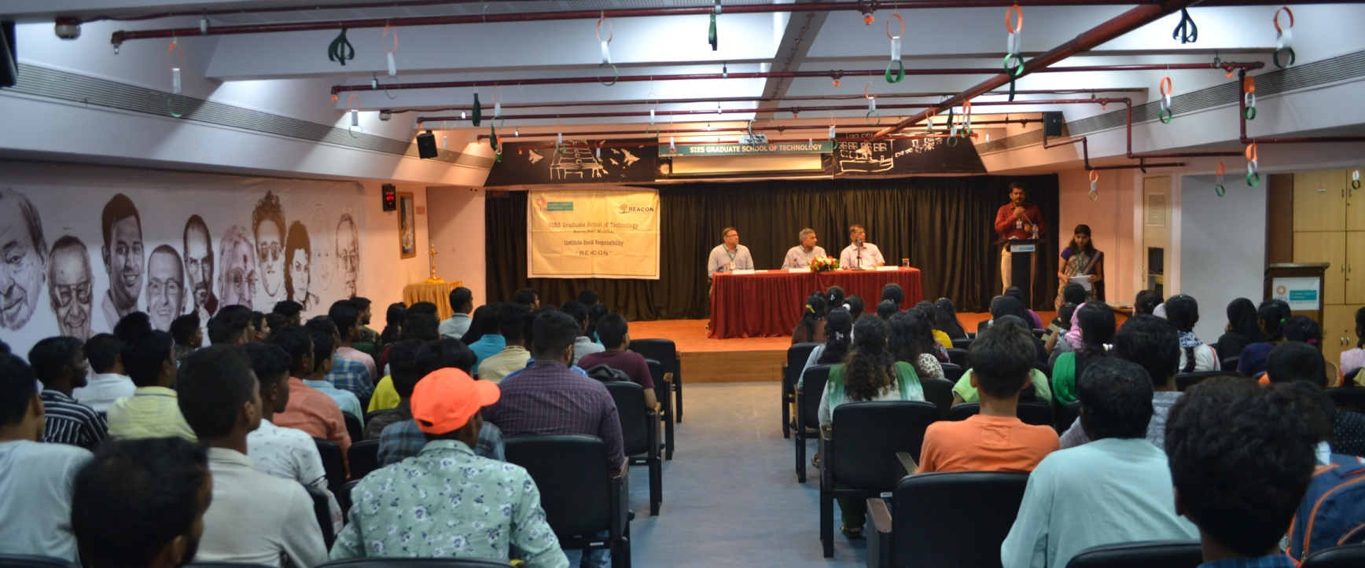
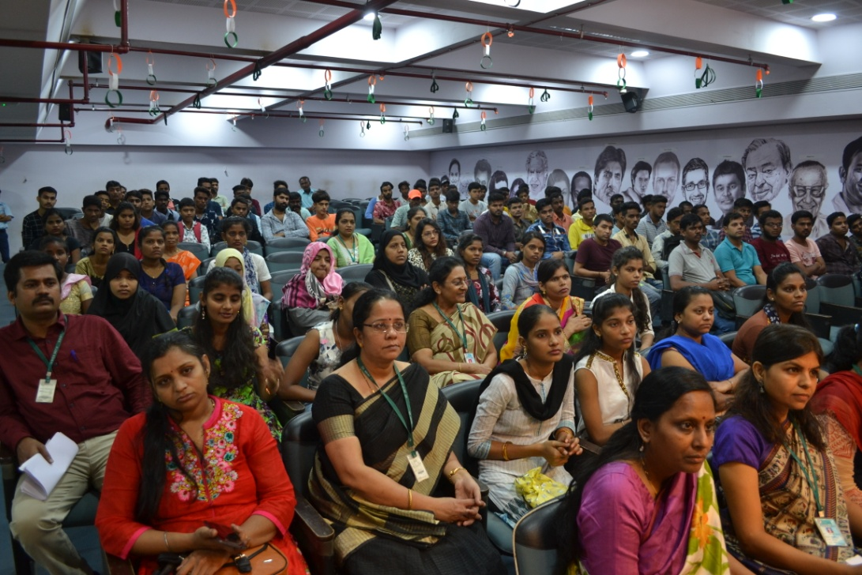

Slide 7
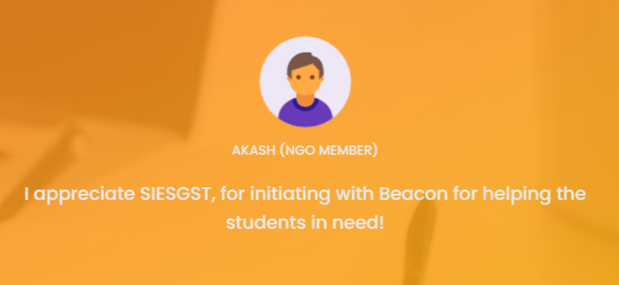
Few Feedback from ISR - Beacon Students

Slide 8
Trades and Qualification
Trade | Carpentry | Sewing & Tailoring | Computer Operator | Web Designing | Electrician | Welding | Plumbing | AC Mechanic
Qualification | 8th fail/pass | 8th fail/pass | 10th fail/pass | 12th fail/pass | 10th fail/pass | 8th fail/pass | 8th fail/pass | 8th fail/pass

Slide 9
Sr.No | Year | Admitted | certified
1 | Jan-June 2016 | 49 | 28
2 | July -Dec 2016 | 40 | 24

Slide 10
Sr.No | Year | Admitted | certified
1 | July -Dec 2017 | 97 | 43
2 | Jan-june 2018 | 13 | 7

Slide 11
July -Dember 2018 Batch
Batch No :-5
Sr.No | COURSES | Application received | confirmed | Rejected | Certificates
1 | ELECTRICIAN | 20 | 10 | 10 | 6
2 | Web Designing | 6 | 3 | 3 | 3
3 | Welding Metal Turinig | 0 | 8 | 0 | 0
4 | Sewing Tailoring | 7 | 5 | 2 | 3
5 | Computer Operator | 10 | 7 | 3 | 0
6 | Basic Ac Mechanic | 11 | 7 | 4 | 1
7 | Screen Printing | 7 | 4 | 3 | 0
8 | Plumbing | 0 | 0 | 0 | 0
 | Total | 61 | 44 | 25 | 13

Slide 12
Jan -July 2019 Batch
Batch No :-6
Sr.No | COURSES | Application received | Confirmed | Rejected | Certificates
1 | ELECTRICIAN | 41 | 31 | 17 | 14
2 | Web Designing | 32 | 30 | 16 | 14
3 | Welding Metal Turinig | 0 | 0 | 0 | 0
4 | Sewing Tailoring | 19 | 17 | 7 | 10
5 | Computer Operator | 36 | 25 | 14 | 11
6 | Basic Ac Mechanic | 32 | 13 | 18 | 3
7 | Screen Printing | 12 | 11 | 7 | 0
8 | Plumbing | 9 | 8 | 6 | 0
 | Total | 181 | 135 | 85 | 52

Slide 13
July -Dec 2019 Batch
Batch No :-7
COURSES | Application received | confirmed | Rejected | Certificates
ELECTRICIAN | 41 | 33 | 8 | 18
Web Designing | 32 | 30 | 2 | 11
Welding Metal Turinig | 10 | 10 | 0 | 4
Sewing Tailoring | 19 | 15 | 4 | 7
Computer Operator | 36 | 34 | 2 | 12
Basic Ac Mechanic | 50 | 27 | 23 | 14
Screen Printing | 9 | 9 | 7 | 2
Plumbing | 8 | 8 | 6 | 2
Total | 205 | 166 | 52 | 70

Slide 14
Jan - July 2020 Batch
Batch No :-8
Sr.No | COURSES | Application received | confirmed | Rejected | Certificates
1 | ELECTRICIAN | 29 | 20 | 9
2 | Web Designing | 23 | 12 | 10
3 | Welding Metal Turinig | 0 | 0 | 0
4 | Sewing Tailoring | 9 | 6 | 3
5 | Computer Operator | 23 | 18 | 7
6 | Basic Ac Mechanic | 9 | 9 | 0
7 | Screen Printing | 0 | 0 | 0
8 | Plumbing | 0 | 0 | 0
 | Total | 93 | 65 | 29

Slide 16
https://drive.google.com/drive/u/3/folders/1AKC_XG6OxM_GpNegKpvXYB9rGWRCNuDn

